Slide 1
Binary Trees
CS 400/600 – Data Structures

Slide 2
Binary Trees
A binary tree is made up of a finite set of nodes that is either empty or consists of a node called the root together with two binary trees, called the left and right subtrees, which are disjoint from each other and from the root.

Slide 3
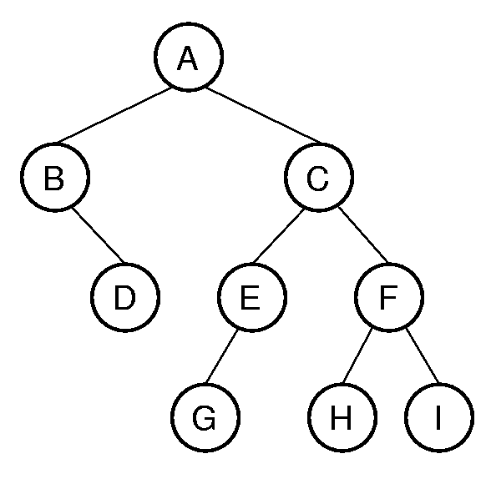
Binary Tree Example
Notation: Node, children, edge, parent, ancestor, descendant, path, depth, height, level, leaf node, internal node, subtree.
Notes:
A has depth 0. B and C from level 1. The tree has height 4. Height = max depth + 1.

Slide 4
Traversals
Any process for visiting the nodes in some order is called a traversal.
Any traversal that lists every node in the tree exactly once is called an enumeration of the tree’s nodes.

Slide 5
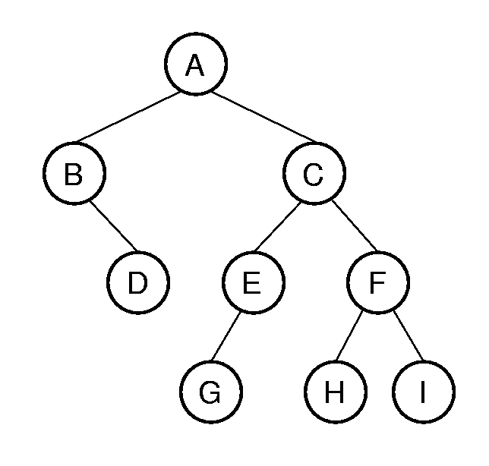
Preorder
Visit current node, then visit each child, left-to-right:
  ABDCEGFHI
Naturally recursive:
// preorder traversal
void preorder(BinNode* current) {
if (current == NULL) return;
visit(current);
preorder(current->left());
preorder(current->right());
}

Slide 6
Postorder
Visit each child, left-to-right, before the current node:
  DBGEHIFCA

Slide 7
Inorder
Only makes sense for binary trees.
Visit nodes in order: left child, current, right child.
  BDAGECHFI

Slide 8
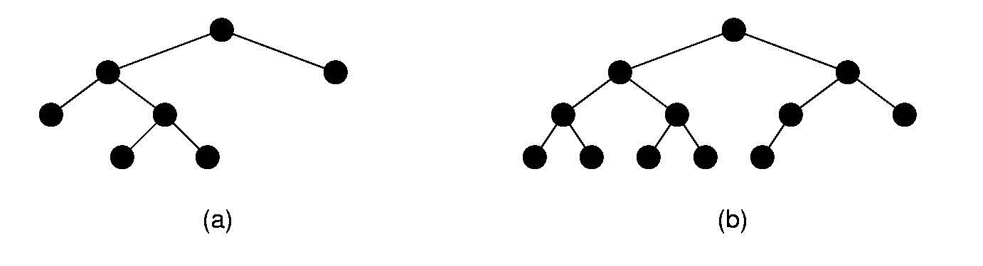
Full and Complete Binary Trees
Full binary tree: Each node is either a leaf or internal node with exactly two non-empty children.
Complete binary tree: If the height of the tree is d, then all levels except possibly level d are completely full. The bottom level has all nodes to the left side.
Full, not complete
Complete, not full
Notes:
These terms can be hard to distinguish. Students will need to remember which is which, since this notation will be used several times during the course.

Slide 9
Full Binary Tree Theorem (1)
Theorem: The number of leaves in a non-empty full binary tree is one more than the number of internal nodes.
Proof (by Mathematical Induction):
Base case: A full binary tree with 1 internal node must have two leaf nodes.
Induction Hypothesis: Assume any full binary tree T containing n-1 internal nodes has n leaves.
Notes:
This theorem is important, because it helps us to calculate space requirements. It tells us how many nodes are internal and how many are leaf. We need to know this if we have separate implementations for internal and leaf nodes

Slide 10
Full Binary Tree Theorem (2)
Induction Step: Given a full binary tree T with n internal nodes, pick internal node I with two leaf children. Remove I’s children, call resulting tree T’.
By induction hypothesis, T’ is a full binary tree with n leaves.
Restore I’s two children. The number of internal nodes has now gone up by 1 to reach n. The number of leaves has also gone up by 1.

Slide 11
Full Binary Tree Corollary
Theorem: The number of null pointers in a non-empty binary tree (not necessarily full – any binary tree!) is one more than the number of nodes in the tree.
Proof: Replace all null pointers with a pointer to an empty leaf node. This is a full binary tree.

Slide 12
A Binary Tree Node ADT
Class BinNode
Elem& val() – return the value of a node
void setVal(const Elem&) – set the value
BinNode* left() – return the left child
BinNode* right() – return the right child
void setLeft(BinNode*) – set the left child
void setRight(BinNode*) – set the right child
bool isLeaf() – return true if leaf node, else false

Slide 13
Representing Nodes
Simplest node representation:
val
left
right
All of the leaf nodes have two null pointers
How much wasted space?
  By our previous corollary, more empty pointers than nodes in the entire tree!
  Sometimes leaf nodes hold more (all) data.

Slide 14
Representing Nodes (2)
We can use inheritance to allow two kinds of nodes: internal and leaf nodes
Base class: VarBinNode
  isLeaf – pure virtual function
Derived classes: IntlNode and LeafNode
Typecast pointers once we know what kind of node we are working with…

Slide 15
Inheritance (1)
class VarBinNode { // Abstract base class
public:
virtual bool isLeaf() = 0;
};
class LeafNode : public VarBinNode { // Leaf
private:
Operand var; // Operand value
public:
LeafNode(const Operand& val)
{ var = val; } // Constructor
bool isLeaf() { return true; }
Operand value() { return var; }
};

Slide 16
Inheritance (2)
// Internal node
class IntlNode : public VarBinNode {
private:
VarBinNode* left; // Left child
VarBinNode* right; // Right child
Operator opx; // Operator value
public:
IntlNode(const Operator& op,
VarBinNode* l, VarBinNode* r)
{ opx = op; left = l; right = r; }
bool isLeaf() { return false; }
VarBinNode* leftchild() { return left; }
VarBinNode* rightchild() { return right; }
Operator value() { return opx; }
};

Slide 17
Inheritance (3)
// Preorder traversal
void traverse(VarBinNode *subroot) {
if (subroot == NULL) return; // Empty
if (subroot->isLeaf()) // Do leaf node
cout << "Leaf: "
<< ((LeafNode *)subroot)->value()
<< endl;
else { // Do internal node
cout << "Internal: "
<< ((IntlNode *)subroot)->value()
<< endl;
traverse(((IntlNode *)subroot)->
leftchild());
traverse(((IntlNode *)subroot)->
rightchild());
}
}

Slide 18
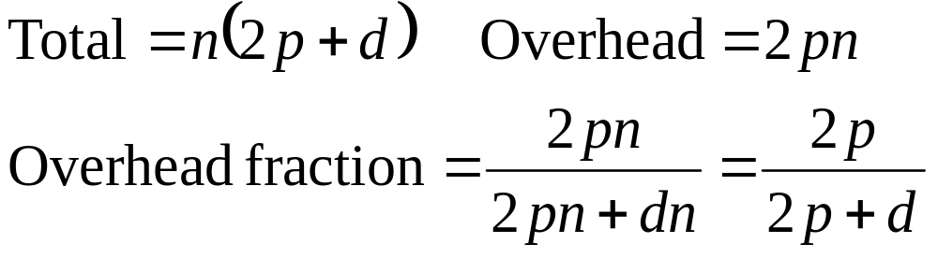
Space requirements for binary trees
Every node stores data (d) and two pointers (p)
  If p = d, about 2/3 overhead
  ½ of this overhead is null pointers

Slide 19
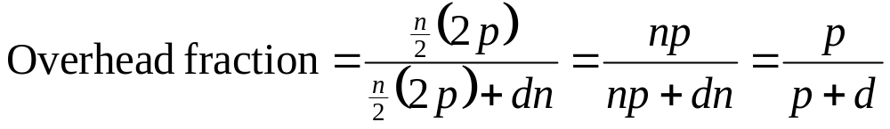
Space requirements for binary trees
No pointers in leaf nodes (~half of all nodes)
  If p = d, about one half of total space is overhead
  No null pointers

Slide 20
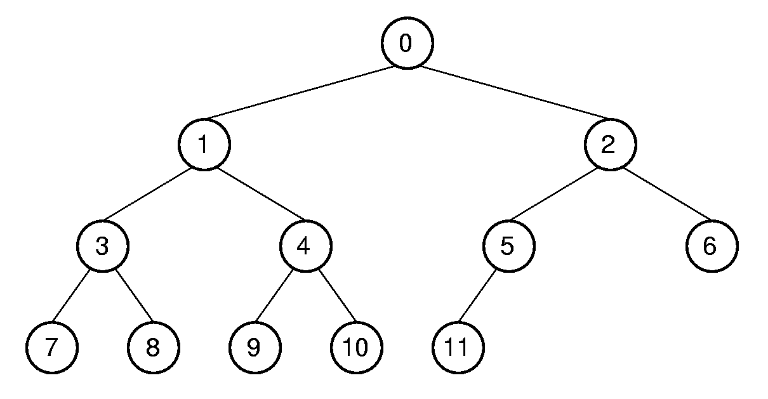
Complete Binary Trees
For a complete tree, we can save a lot of space by storing the tree in an array (no pointers!)
0 1 2 3 4 5 6 7 8 9 10 11

Slide 21
Array Representation
How can we find parents, children, siblings?
Position | 0 | 1 | 2 | 3 | 4 | 5 | 6 | 7 | 8 | 9 | 10 | 11
Parent | -- | 0 | 0 | 1 | 1 | 2 | 2 | 3 | 3 | 4 | 4 | 5
Left Child | 1 | 3 | 5 | 7 | 9 | 11 | -- | -- | -- | -- | -- | --
Right Child | 2 | 4 | 6 | 8 | 10 | -- | -- | -- | -- | -- | -- | --
Left Sibling | -- | -- | 1 | -- | 3 | -- | 5 | -- | 7 | -- | 9 | --
Right Sibling | -- | 2 | -- | 4 | -- | 6 | -- | 8 | -- | 10 | -- | --

Slide 22
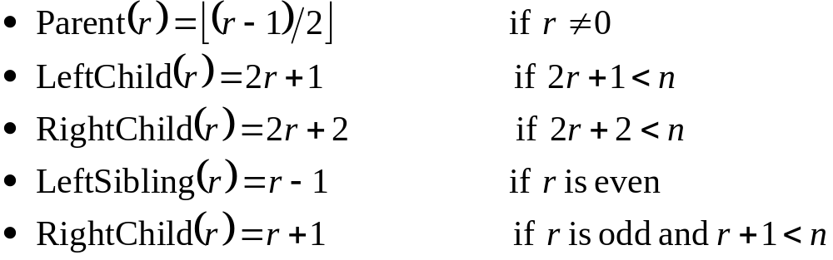
Array Relationships
Position | 0 | 1 | 2 | 3 | 4 | 5 | 6 | 7 | 8 | 9 | 10 | 11
Parent | -- | 0 | 0 | 1 | 1 | 2 | 2 | 3 | 3 | 4 | 4 | 5
Left Child | 1 | 3 | 5 | 7 | 9 | 11 | -- | -- | -- | -- | -- | --
Right Child | 2 | 4 | 6 | 8 | 10 | -- | -- | -- | -- | -- | -- | --
Left Sibling | -- | -- | 1 | -- | 3 | -- | 5 | -- | 7 | -- | 9 | --
Right Sibling | -- | 2 | -- | 4 | -- | 6 | -- | 8 | -- | 10 | -- | --

Slide 23
Binary Search Trees
BST Property: All elements stored in the left subtree of a node with value K have values < K. All elements stored in the right subtree of a node with value K have values >= K.

Slide 24
Searching the tree
Bool find(const Key& K, Elem& e) const
{ return findhelp(root, K, e); }
template <class Key, class Elem,
class KEComp, class EEComp>
bool BST<Key, Elem, KEComp, EEComp>::
findhelp(BinNode<Elem>* subroot,
const Key& K, Elem& e) const {
if (subroot == NULL) return false;
else if (KEComp::lt(K, subroot->val()))
return findhelp(subroot->left(), K, e);
else if (KEComp::gt(K, subroot->val()))
return findhelp(subroot->right(), K, e);
else { e = subroot->val(); return true; }
}

Slide 25
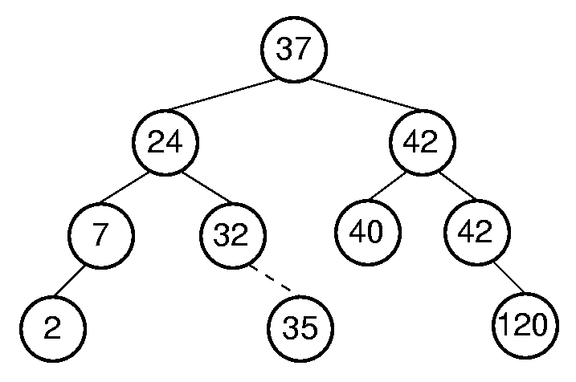
Inserting into the tree
Find an appropriate leaf node, or internal node with no left/right child
Insert the new value
Can cause the tree to
become unbalanced

Slide 26
An unbalanced tree
Suppose we insert 3, 5, 7, 9, 11, 13, 6
3
5
7
6
9
13

Slide 27
Cost of search
Worst case cost = depth of tree
  Worst case: tree linear, cost = n
  Best case: perfect balance, cost = lg(n)

Slide 28
BST insert
template <class Key, class Elem,
class KEComp, class EEComp>
BinNode<Elem>* BST<Key,Elem,KEComp,EEComp>::
inserthelp(BinNode<Elem>* subroot,
const Elem& val) {
if (subroot == NULL) // Empty: create node
return new BinNodePtr<Elem>(val,NULL,NULL);
if (EEComp::lt(val, subroot->val()))
subroot->setLeft(inserthelp(subroot->left(),
val));
else subroot->setRight(
inserthelp(subroot->right(), val));
// Return subtree with node inserted
return subroot;
}

Slide 29
Deleting
When deleting from a BST we must take care that…
  The resulting tree is still a binary tree
  The BST property still holds
To start with, consider the case of deleting the minimum element of a subtree

Slide 30
Removing the minimal node
Move left until you can’t any more
  Call the minimal node S
Have the parent of S point to the right child of S
  There was no left child, or we would have taken that link
  Still less than S’s parent, so BST property maintained
  NULL links are ok

Slide 31
Removing the min
…deletemin(BinNode<Elem>* subroot,
BinNode<Elem>*& min) {
if (subroot->left() == NULL) {
min = subroot;
return subroot->right();
}
else { // Continue left
subroot->setLeft(
deletemin(subroot->left(), min));
return subroot;
}
}

Slide 32
DeleteMin
--
10
8
5
5
8
10
deletemin(10)
setleft(deletemin(8))
setleft(deletemin(5))
min = 5
return 6
return 8
return 10
10
8
20
5
6

Slide 33
Deleting an arbitrary node
If we delete an arbitrary node, R, from a BST, there are three possibilities:
  R has no children – set it’s parent’s pointer to null
  R has one child – set the parent’s pointer to point to the child, similar to deletemin
  R has two children – Now what?
    We have to find a node from R’s subtree to replace R, in order to keep a binary tree.
    We must be careful to maintain the BST property

Slide 34
Which node?
Which node can we use to replace R?
  Which node in the tree will be most similar to R?
  Depends on which subtree:
    Left subtree: rightmost
      Everything in the right
      subtree is greater,
      everything in the left
      subtree is smaller
    Right subtree: leftmost
      Everything in the left
      subtree is smaller,
      everything in the right
      subtree is greater

Slide 35
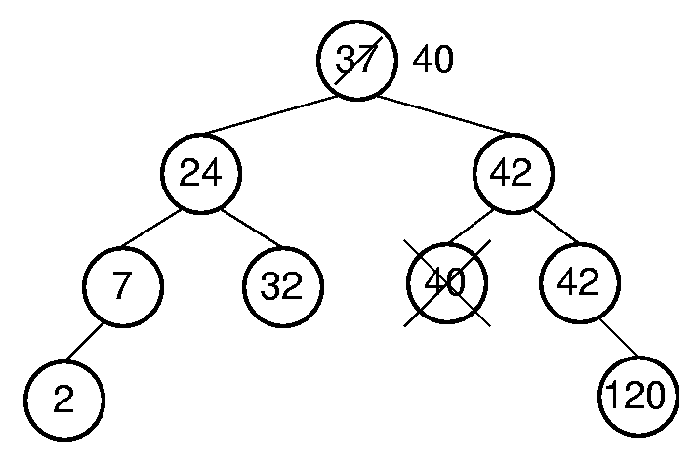
BST delete

Slide 36
Duplicate values
If there are no duplicates, either will work
Duplicates
  Recall that the left subtree has values < K, while the right has values ≥ K.
  Duplicates of K must be in the right subtree, so we must choose from the right subtree if duplicates are allowed.

Slide 37
Heaps and priority queues
Sometimes we don’t need a completely sorted structure. Rather, we just want to get the highest priority item each time.
A heap is complete binary tree with one of the following two properties…
  Max-heap: every node stores a value greater than or equal to those of its children (no order imposed on children)
  Min-heap: every node stores a value less than or equal to those of its children

Slide 38
Max-heap not-so-abstract data type
template<class Elem,class Comp> class maxheap{
private:
Elem* Heap; // Pointer to the heap array
int size; // Maximum size of the heap
int n; // Number of elems now in heap
void siftdown(int); // Put element in place
public:
maxheap(Elem* h, int num, int max);
int heapsize() const;
bool isLeaf(int pos) const;
int leftchild(int pos) const;
int rightchild(int pos) const;
int parent(int pos) const;
bool insert(const Elem&);
bool removemax(Elem&);
bool remove(int, Elem&);
void buildHeap();
};

Slide 39
Array representation
Since a heap is always complete, we can use the array representation for space savings
7
4
6
1
2
3
5
7 4 6 1 2 3 5

Slide 40
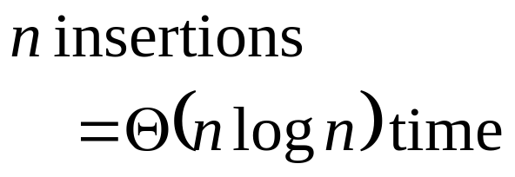
Heap insert
Add an element at the end of the heap
While (smaller than parent) {swap};
15
15
12
9
12
17
8
10
17
8
10
9
17
12
15
8
10
9

Slide 41
Batch insert
If we have the entire (unsorted) array at once, we can speed things up with a buildheap() function
If the right and left subtrees are
already heaps, we can sift nodes
down the correct level by
exchanging the new root with
the larger child value
  New structure will be a heap, except that R may not be the smallest value in its subtree
  Recursively sift R down to the correct level
R
h₁
h₂

Slide 42
Siftdown
1
7
5
7
5
1
4
2
6
3
4
2
6
3
7
5
6
4
2
1
3

Slide 43
Siftdown (2)
For fast heap construction:
Work from high end of array to low end.
Call siftdown for each item.
Don’t need to call siftdown on leaf nodes.
template <class Elem, class Comp>
void maxheap<Elem,Comp>::siftdown(int pos) {
while (!isLeaf(pos)) {
int j = leftchild(pos);
int rc = rightchild(pos);
if ((rc<n) && Comp::lt(Heap[j],Heap[rc]))
j = rc;
if (!Comp::lt(Heap[pos], Heap[j])) return;
swap(Heap, pos, j);
pos = j;
}}

Slide 44
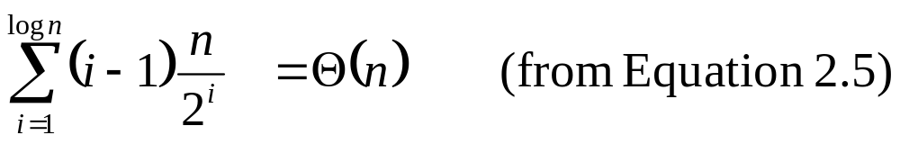
Cost of buildheap()
Work from high index to low so that subtrees will already be heaps
Leaf nodes can’t be sifted down further
Each siftdown can cost, at most, the number of steps for a node to reach the bottom of the tree
  Half the nodes, 0 steps (leaf nodes)
  One quarter: 1 step max
  One eighth: 2 steps max, etc.

Slide 45
The whole point
The most important operation: remove and return the max-priority element
  Can’t remove the root and maintain a complete binary tree shape
  The only element we can remove is the last element
  Swap last with root and siftdown()
  Θ(log n) in average and worst cases
Changing priorities: not efficient to find arbitrary elements, only the top.
  Use an additional data structure (BST) with pointers

Slide 46
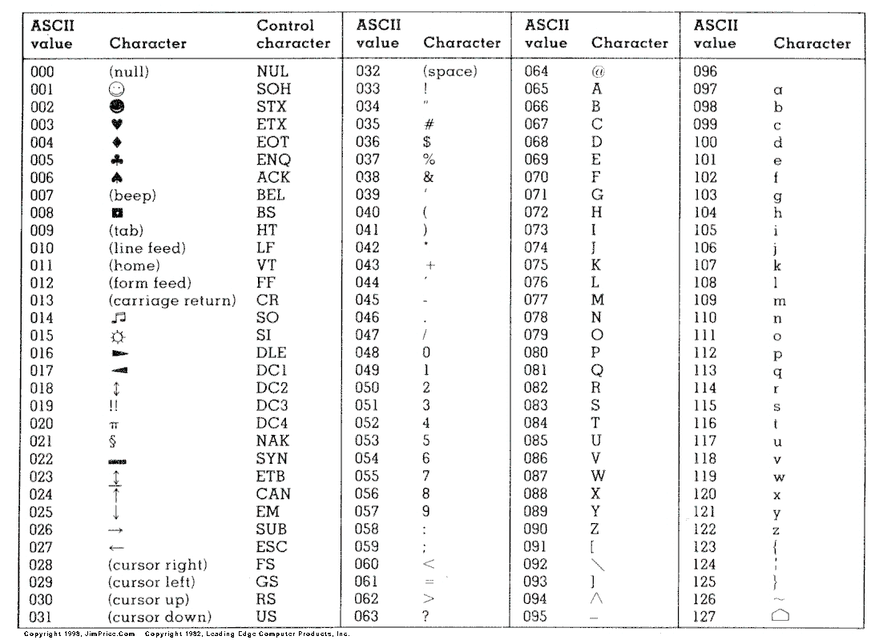
Coding schemes
ASCII – a fixed length coding scheme:

Slide 47
Variable length scheme
In general, letters such as s, i, and e are used more often than, say z.
If the code for s is 01, and the code for z is 1001011, we might be able to save some space
  No other code can start with 01, or we will think it is an s

Slide 48
The Huffman Tree
A full binary tree with letters at the leaf nodes and labeled edges
Assign weights to the letters that represent how often they are used
  s – high weight, z – low weight
How do we decide how often? What type of communications?

Slide 49
Building a Huffman tree
To start, each character is its own (full) binary tree
Merge trees with lowest weights
New weight is sum of previous weights
Continue…

Slide 50
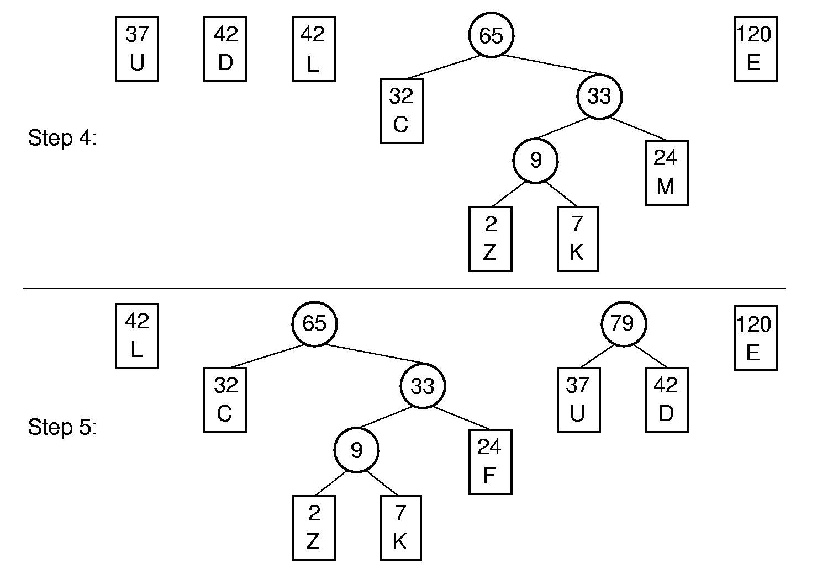
Building a Huffman tree (2)

Slide 51
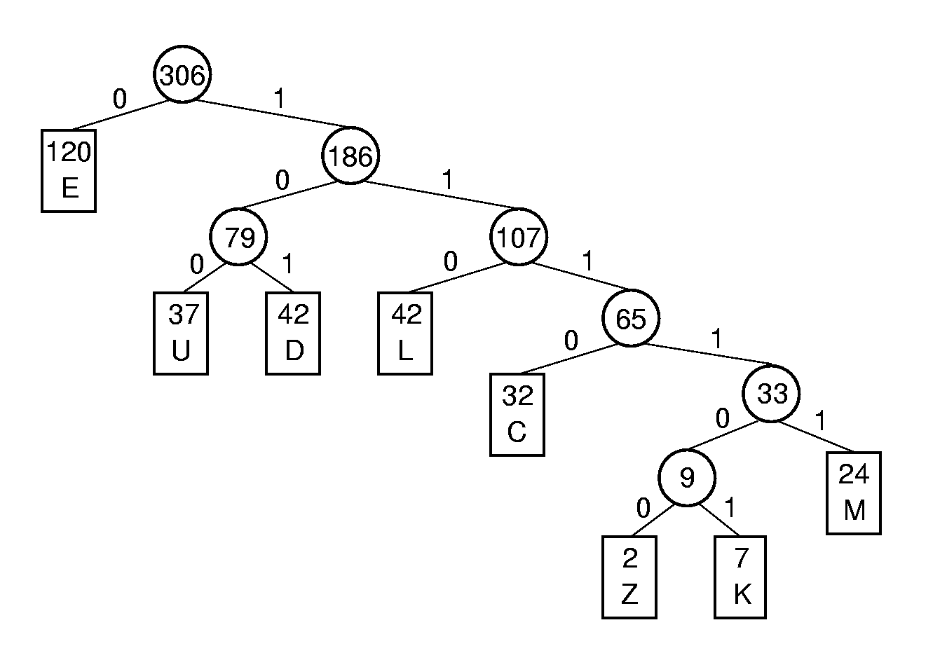
Assigning codes
Letter | Freq | Code | Bits
C | 32
D | 42
E | 120
F | 24
K | 7
L | 42
U | 37
Z | 2
Notes:
C: 1110
D: 101
E: 0
F: 1111
K: 111101
L: 110
U: 100
Z: 111100

Slide 52
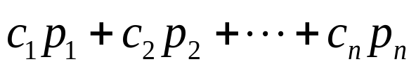
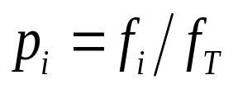
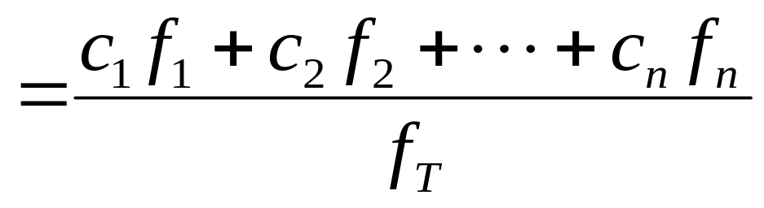
Properties of Huffman codes
No letters at internal nodes, so no character has a code that is a prefix of another character’s code.
What if we write a message with a lot of z’s?
Average character cost:
where

